Slide 1
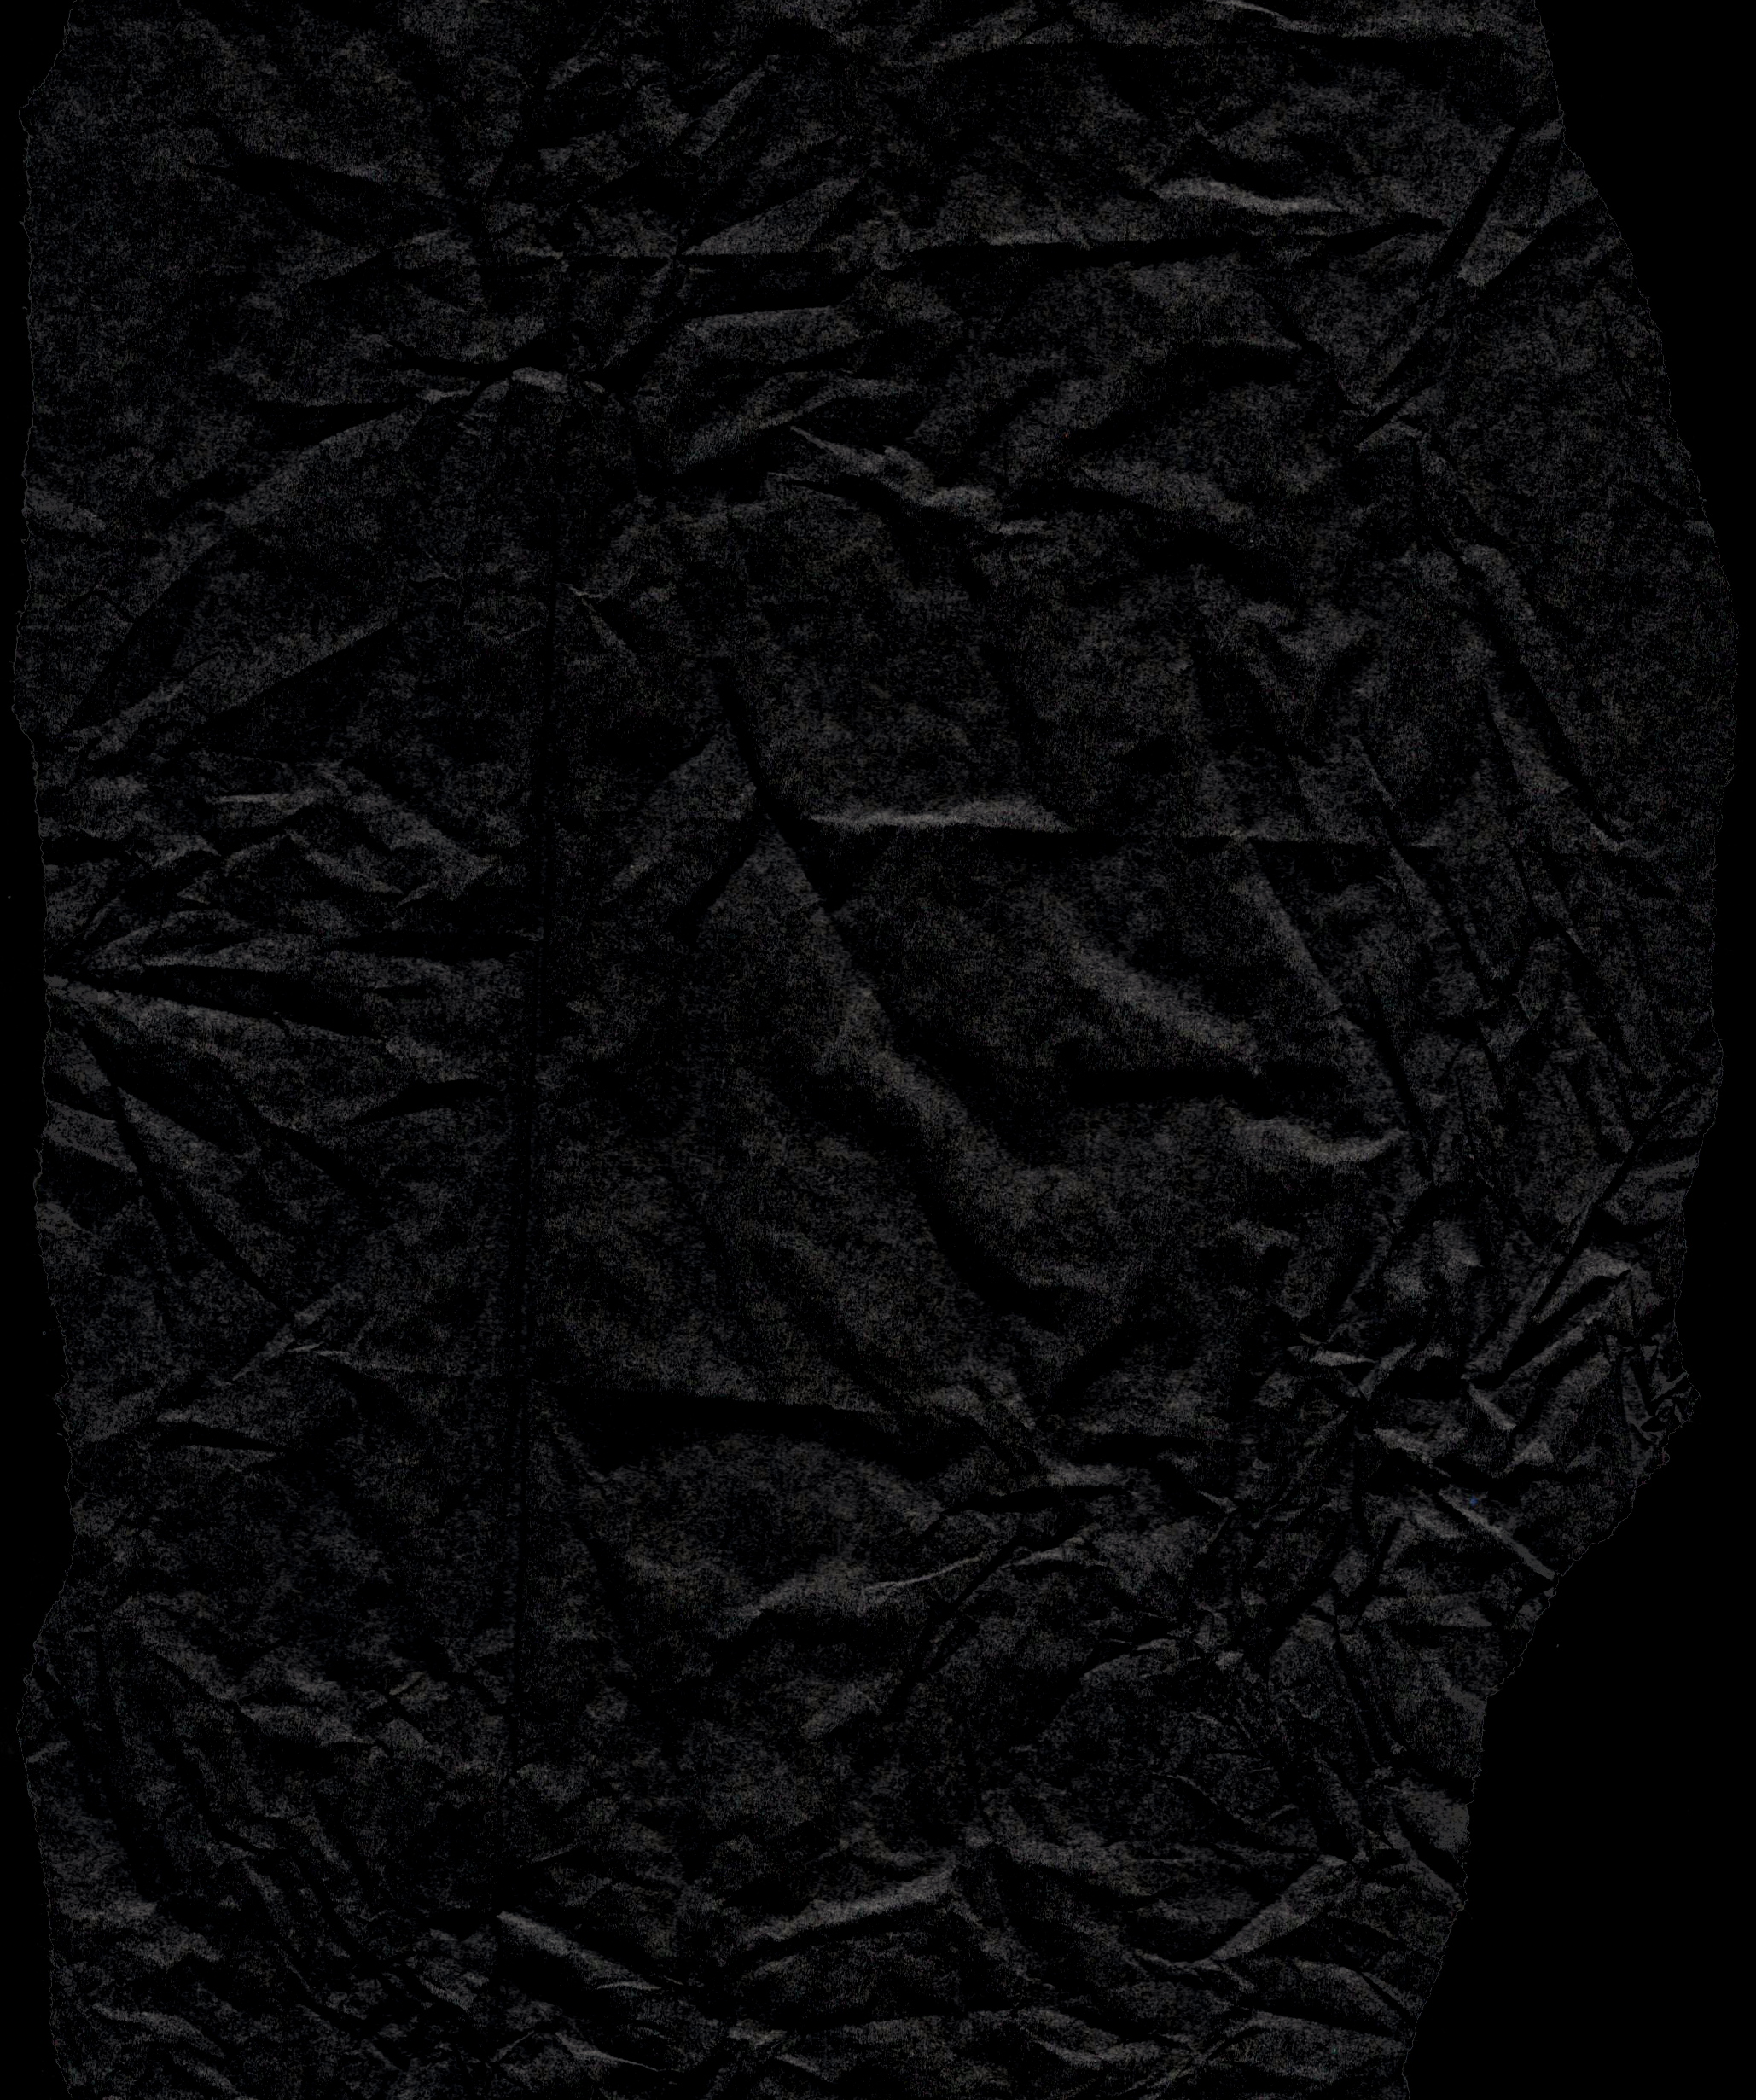

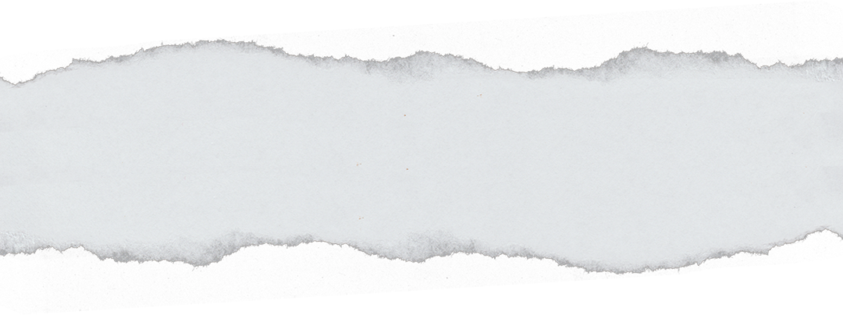
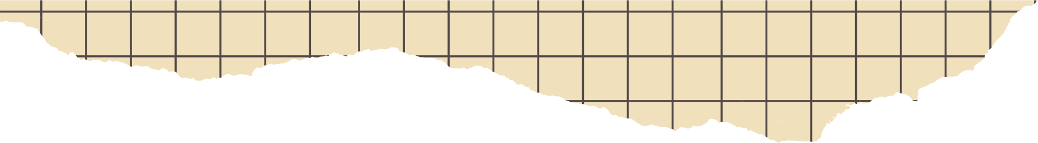



SIGN LANGUAGE
DETECTION
Supervisor- Dr. Suresh Kumar

Slide 2



TEAM MEMBERS
ANANYA SEHGAL
HARSH MEHLAWAT
BHAVISHYA CHAWLA

Slide 3



OBJECTIVE/PROBLEM STATEMENT
The objective of this project is to create a robust sign language classification system capable of accurately recognizing and translating a wide range of sign language gestures in real-time. The system should be user-friendly, efficient, and accessible, bridging the communication gap between individuals who use sign language and those who do not.

Slide 4




EXISTING WORK WITH LIMITATIONS
1.Accuracy and Reliability: Despite advancements in technology, sign language interpretation may not always be 100% accurate, leading to potential misunderstandings or miscommunications between users.
2.Technological Constraints: The performance of the software may be impacted by technological constraints such as hardware limitations, processing power, and network connectivity issues. Real-time processing of video streams and complex algorithms may require significant computational resources, limiting the software's functionality on certain devices or network conditions.
3.Dependency on External Factors: The effectiveness of the software may depend on external factors such as lighting conditions, background noise, and the quality of video input.

Slide 5
PROPOSED WORK
The learning aids for hearing and speech disabled people exist but the usage of these aids are limited. The proposed system would be a real time system wherein live sign gestures would be processed using image processing.Then classifiers would be used to differentiate various signs and the translated output would be displaying text . Machine Learning algorithms will be used to train on the data set. The purpose of the system is to improve the existing system in this area in terms of response time and accuracy with the use of efficient algorithms, high quality data sets.

Slide 6



METHODOLOGY
Data Collection:
Gather a dataset of sign language gestures.
Data Preprocessing:
Clean the data by removing noise, standardizing hand positions, and normalizing the images to a consistent format.
Feature Extraction:
Extract features from the preprocessed images. This can involve techniques like edge detection, convolutional neural networks (CNNs) to capture important visual information from the gestures.
Model Training:
Train the selected model using the preprocessed data. Use techniques like data augmentation to increase the diversity of the training data and prevent overfitting.
Deployment:
Deploy the trained model in a real-world setting. This can involve integrating the model into a software application or a hardware device capable of capturing and interpreting sign language gestures in real time.

Slide 7

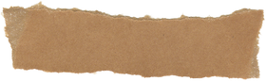



NOVELTY OF PROJECT
For many people: Sign language interpreters might not seem novel at all. They are a recognized profession that plays a vital role in facilitating communication between the Deaf and hearing communities.
For someone unfamiliar with Deaf culture: Encountering a sign language interpreter for the first time could be a new experience.
The concept of translation between spoken languages might seem ordinary, but seeing a translator using a physical language (sign language) to convey spoken language can be interesting.
So, the novelty of sign language interpreters depends on the audience and the context.

Slide 8

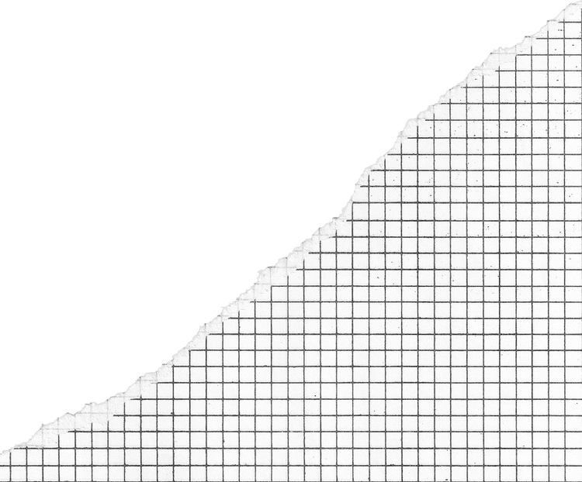
LITERATURE REVIEW
(Haitham Badi, 2016) present a study to explain the advantage
of two feature extraction techniques to process gestures
distinguish problems based on hand contour and complex
moments. The author suggested six fixed hand signals namely
open and close, cut and paste, maximize and reduce, to develop
a vision based on a fixed hand gesture recognition algorithm.
The classification way and identify hand signs in image in SL
have been using back-propagation learning algorithm, which
was implemented in three phases: the first is preprocessing,
second phase feature extraction, and the last phase classification
by Artificial Neural Network ANN technique.
The identification accuracy of hand contour was 71.30%, while
the best recognition rate of complex moments was 86.90%. The
drawback of this method was the suffering of a neural network
from overfitting.
(SALMA HAYANI, ET.AL., 2019) PRESENTED AN AUTOMATIC WAY TO
recognition Arabic sign language letters and numbers based on
CNN. The proposed CNN consist of seven layers, where the
first four layers focus on the feature extraction and the rest three
layers for classification. The recognition rate is about 90%.
P.K. ATHIRA, ET.AL. (2019) SUGGEST A DESIGN INDEPENDENT
version vision-based signs recognition application which is
identify gesture handed static and dynamic for one or double
hand gestures from live video. The keyframe is extracting to
decrease computation speed to a large range by using Zernike
moments and enhanced process for co-articulation removal
hand spelling alphabets after that which is extraction the feature
vector from the gesture sequence and these features acquired to
use for classification applying Support Vector Machine
(SVM). the accuracy 91% for distinguished static gesture
alphabets and 89% accuracy for single-handed dynamic words.

Slide 9
REAL-TIME USAGE
EDUCATIONAL SETTINGS: FACILITATES LEARNING AND PARTICIPATION FOR DEAF/HARD-OF-HEARING STUDENTS IN CLASSROOMS AND LECTURES.
HEALTHCARE AND LEGAL SETTINGS: ENSURES EFFECTIVE COMMUNICATION DURING CONSULTATIONS, MEETINGS, AND LEGAL PROCEEDINGS.
PUBLIC EVENTS AND CONFERENCES: ALLOWS DEAF/HARD-OF-HEARING INDIVIDUALS TO PARTICIPATE FULLY IN PRESENTATIONS, DISCUSSIONS, AND OTHER GATHERINGS.
MEDIA AND ENTERTAINMENT ACCESSIBILITY: ENABLES DEAF/HARD-OF-HEARING INDIVIDUALS TO ENJOY MOVIES, SHOWS, AND PRESENTATIONS WITH SIGN LANGUAGE INTERPRETATION.
REMOTE COMMUNICATION: FACILITATES COMMUNICATION THROUGH VIDEO CONFERENCING AND ONLINE PLATFORMS FOR DEAF/HARD-OF-HEARING INDIVIDUALS.

Slide 10


HARDWARE & SOFTWARE REQUIREMENTS
HARDWARE
Camera or input device for capturing sign language gestures.
Programming languages: Python for development.
Deep learning frameworks: TensorFlow, PyTorch, or Keras.
Computer vision libraries: Mediapipe and OpenCV for image processing.
Development environment: IDEs such as Jupyter Notebook, PyCharm, or Visual Studio Code.
SOFTWARE

Slide 11
MODULES
1.DATASET
2.IMAGE DETECTION
3.FEATURE EXTRACTION
4.FEATURE EXTRACTION
5.OUTPUT

Slide 12


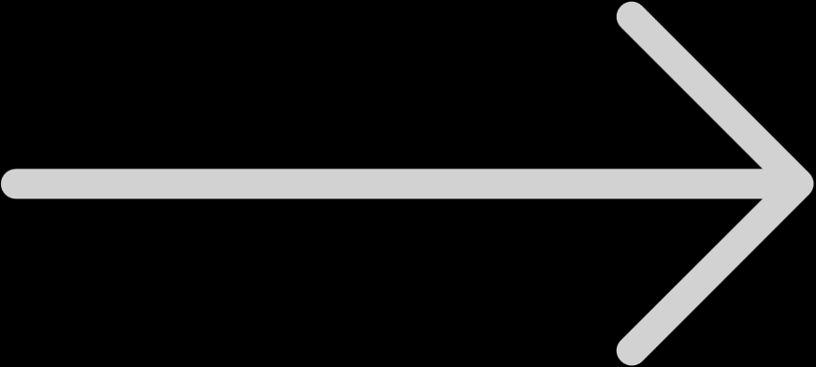



1.Data Set:
In this step, a set of images for each letter in the sign language is fed to a database. The number of images may vary from 100 to 200, with different angles of each particular gesture included.
5 Output:
The camera gets the input gesture image from the user, the detection process takes place to check if it is a hand or not using certain algorithms, image recognition is the next step where the image acquired from the user is compared with the images in the dataset, to interpret the shown gesture. Image recognition is done using a model known as CNN . The next step is the output where the recognized symbol is converted to text form as the output.
MODULE
WORKFLOW
2.Image detection:
This is the step that comes right after camera capture. Image detection refers to detecting the image that is obtained and, in this case, it is found out if the obtained image is that of a hand or not.
4 Image Recognition:
Image recognition is the most crucial procedure of this project. The acquired image is converted to its vector form. The model used is CNN, Convolutional Neural Network. CNN is used to analyze data and classify them.
3.Feature Extraction:
Feature extraction refers to extracting the details from the image captured. In a sign language interpreter, the image captured is a gesture made by a hand. Therefore, the features extracted from such images include the size of the palm, the number of fingers open, etc. These features are then used to recognize the gesture using certain algorithms.

Slide 13
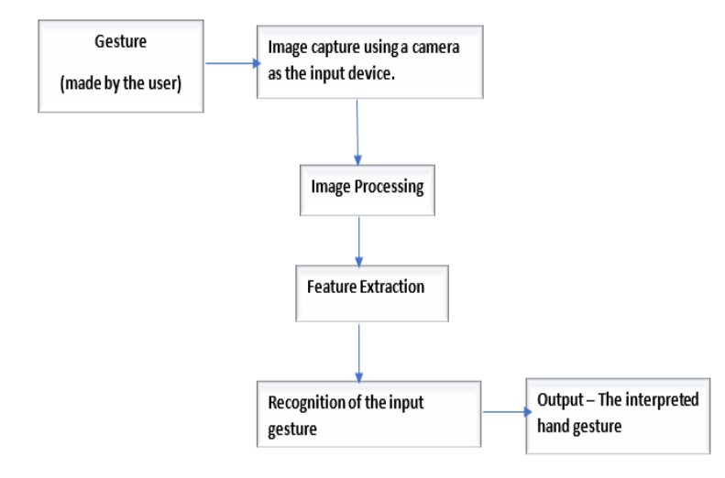
SYSTEM ARCHITECTURE DIAGRAM

Slide 14
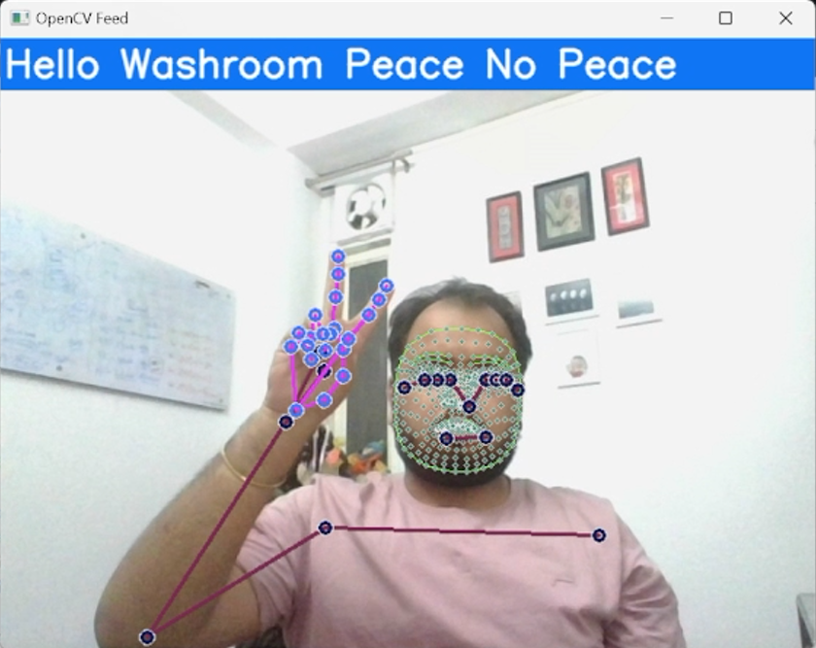
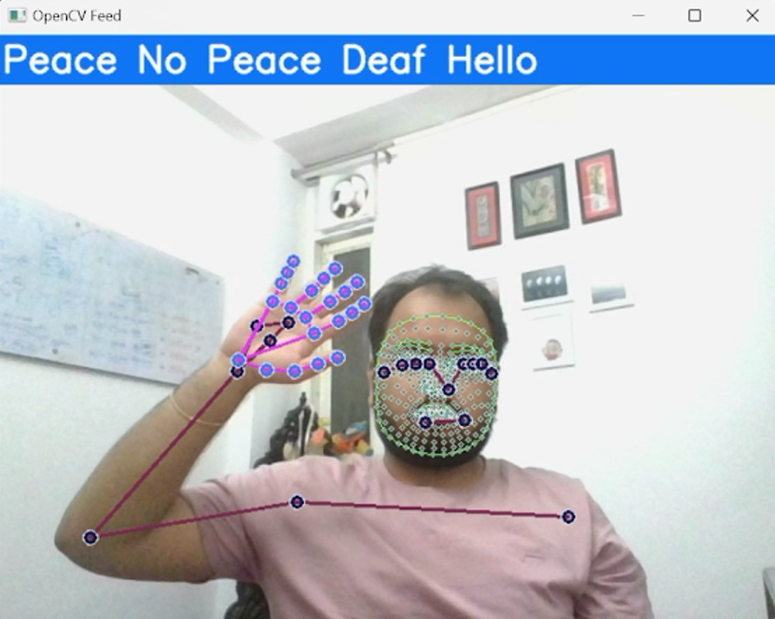
Output Results:

Slide 15
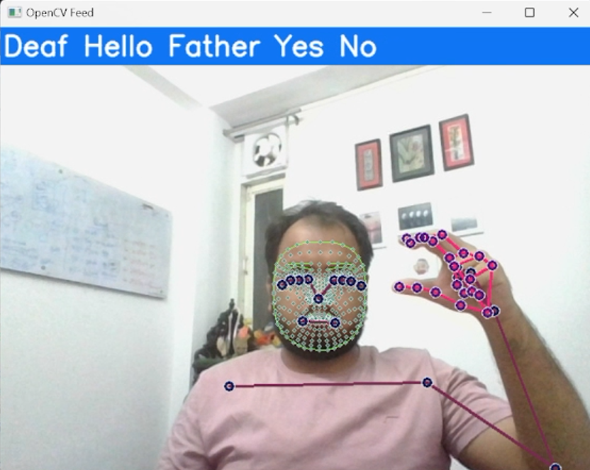
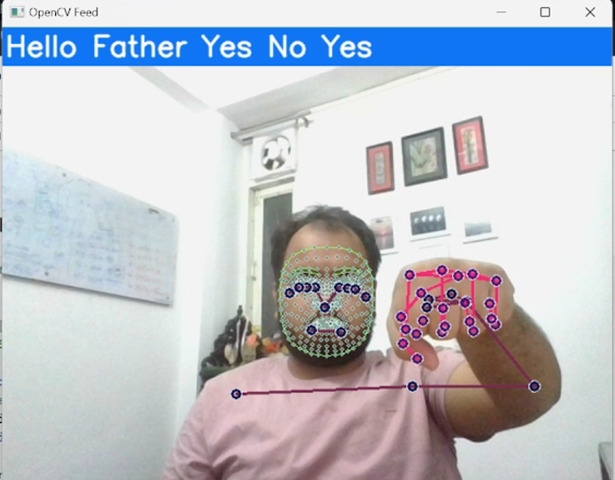
Output Results:

Slide 16
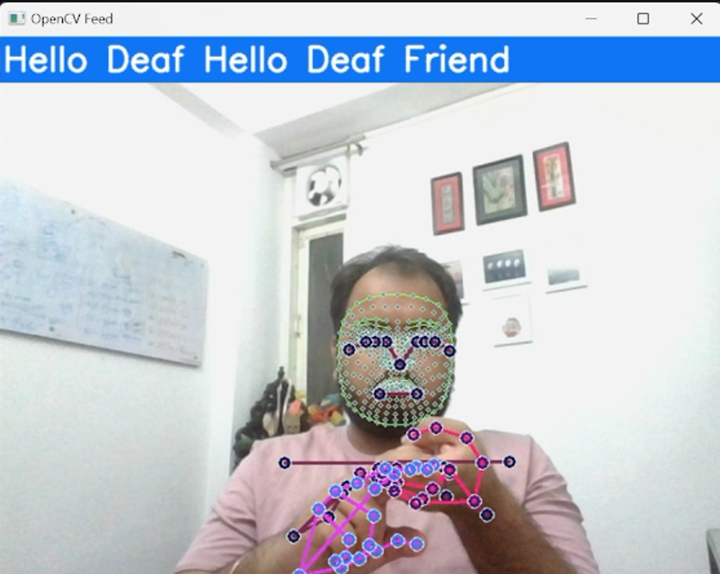
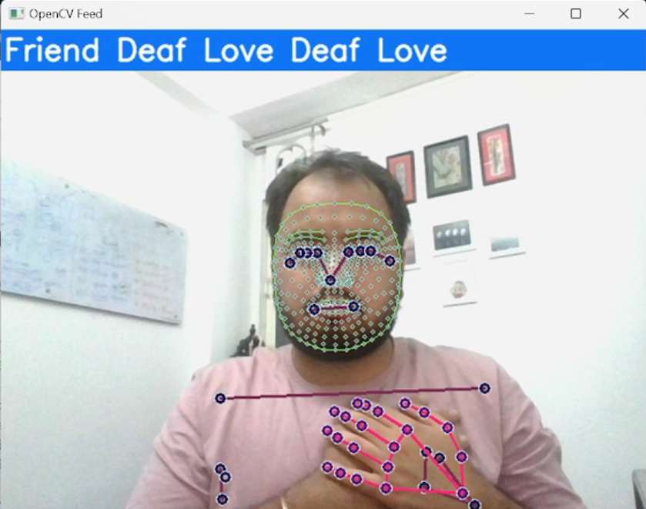
Output Results:

Slide 17
RESULT AND DISCUSSION
Output:
Written Text: In specific scenarios, the interpreter might write down the message for clarity or future reference.
Alternative Gestures: Sometimes, the interpreter might use more universally understood gestures to ensure clear communication for a wider audience.
FUNCTION: A HAND GESTURE INTERPRETER ACTS AS A BRIDGE BETWEEN VISUAL COMMUNICATION THROUGH HAND GESTURES AND WRITTEN LANGUAGE.
Input:
Hand Gestures: The interpreter analyzes the hand positions, movements, and orientations.
Body Language: These provide additional context and meaning to the gestures.
DISCUSSION:
SPECIFICITY: HAND GESTURE INTERPRETERS MAY SPECIALIZE IN INTERPRETING GESTURES USED IN SPECIFIC DOMAINS LIKE TRAFFIC CONTROL, MEDICAL PROCEDURES, OR GAMING AND FOR DEAF PEOPLE TO COMMUNICATE.

Slide 18
CONCLUSION
Sign language translation through machine learning offers a promising avenue to bridge communication gaps for the deaf and hard of hearing communities. By leveraging machine learning algorithms, we can decipher hand gestures, facial expressions, and body language to interpret signs and convert them into text or spoken language, thus facilitating communication.
Nonetheless, this field encounters several challenges. Sign languages exhibit complexity and regional variations, posing hurdles for accurate translation. Moreover, machine learning models necessitate extensive datasets for training and may be susceptible to inaccuracies stemming from factors such as lighting conditions and background noise.
Furthermore, our model demonstrates proficiency in predicting essential words crucial for sign language translation, including 'Deaf,' 'Father,' 'Friend,' 'Goodluck,' 'Hello,' 'Love,' 'Mother,' 'No,' 'Peace,' 'Please,' 'Thanks,' 'Washroom,' 'Yes,' with an impressive accuracy of 0.8. This capability underscores the effectiveness and reliability of our model in facilitating accurate sign language translation and communication.

Slide 19


THANK YOU

